Slide 1


My Details
Name : Shaik Naseer Hussain
Skills Build Email ID : shaiknaseer6836@gmail.com
College Name : Sri Venkateswara Engineering College, Tirupati.
College State : Andhra Pradesh
Internship Domain : Artificial Intelligence
Duration : June 05 – July 23

Slide 2


Problem Statement
The problem at hand is to analyze Employee Burnout using machine learning techniques.
The objective is to develop a model that can predict and identify signs of burnout in employees based on various input features.
The analysis will involve collecting relevant data such as Gender, Designation, WFH setup, Mental Fatigue score, Resource Allocation, Company type etc..
I performed EDA on various features to find out valuable hidden insights between them.
The aim is to create a predictive model that can accurately classify employees as either at risk of burnout or not.
The project seeks to provide valuable insights and actionable recommendations to employers for effective burnout prevention and employee well-being initiatives.

Slide 3

Agenda
This Presentation contains :
Project Overview
Who Are End Users ?
Solution and it’s value Proposition
Data Cleaning & Insight Generation
Modeling
Results/Outputs
Reference Links

Slide 4
Project Overview
Project Overview: The employee burnout analysis project aims to understand and address burnout in the workplace using machine learning. Burnout is a state of chronic physical and emotional exhaustion caused by excessive work demands and stress. The project seeks to identify signs of burnout and provide insights for prevention and well-being.
Purpose: The purpose is to analyze and predict employee burnout to support organizations in creating a healthier work environment. By understanding the factors contributing to burnout, employers can take proactive measures to prevent it and enhance employee well-being and job satisfaction.
Scope: The project focuses on analyzing various factors related to burnout, such as designation, resmyce allocated, mental fatigue score, WFH setup. The scope extends to developing a machine learning model that can predict burnout risk and provide actionable insights for intervention strategies.
Objective: The objective is to develop a model that predicts employee burnout and identifies the key factors influencing it. The analysis aims to provide insights and recommendations for organizations to implement targeted interventions and improve employee well-being. By addressing burnout, the project seeks to enhance employee satisfaction, productivity, and overall organizational success.

Slide 5
Who are the end users?
The end users targeted in the Employee Burnout analysis project are people based on their Designation from 1-5 having their assigned positions ,include HR professionals, organizational leaders and managers, occupational health and safety teams, EAP providers, and executives/decision-makers. The project aims to provide these users with insights and recommendations to identify burnout risk factors, develop interventions, promote employee well-being, and improve organizational health.
By targeting these end users, the employee burnout analysis project aims to provide actionable insights and recommendations that can be implemented at different levels within an organization to address burnout and promote employee well-being.

Slide 6
My solution and it’s value proposition
My solution for employee burnout analysis addresses the needs of end users and brings significant
value through the following:
Identifying burnout risk factors based on employee demographics and work-related variables.
Enabling targeted interventions to prevent burnout and improve employee well-being.
Enhancing team productivity and morale by addressing burnout within teams.
Mitigating burnout risks through proactive measures and creating a safer work environment.
Tailoring employee assistance programs to address specific burnout risks.
Providing resmyces and interventions that directly target burnout factors.
Enabling informed decision-making by understanding the impact of burnout on organizational performance.
Promoting a sustainable and thriving work environment for long-term organizational success.

Slide 7
How did I customized the project and make it my own?
Comprehensive Data Analysis: My solution utilizes advanced machine learning algorithms to analyze a wide range of data, including demographics, work-related variables, and psychological indicators. This comprehensive approach provides a holistic understanding of burnout, going beyond traditional methods.
Predictive Modeling: My employ predictive modeling techniques to identify burnout risk factors and predict individual susceptibility to burnout. By leveraging machine learning, my solution can anticipate burnout risks before they manifest, enabling proactive interventions.
Feature Engineering: My solution incorporates advanced feature engineering techniques to extract meaningful insights from complex data. This creative process enhances the accuracy and interpretability of the analysis, enabling us to uncover hidden patterns and relationships.
Actionable Recommendations: My solution goes beyond data analysis by providing actionable recommendations tailored to individual employees or teams. These recommendations address specific burnout risk factors, empowering organizations to implement targeted interventions effectively.
Real-Time Insights: By leveraging advanced data processing and analysis techniques, my solution can generate real-time insights. This allows organizations to make timely interventions, enhancing the effectiveness of burnout prevention strategies.
Value-Driven Approach: My solution is driven by the value it brings to organizations and employees. We aim to make a positive impact by improving employee well-being, reducing burnout-related costs, and fostering a more engaged and productive workforce.

Slide 8
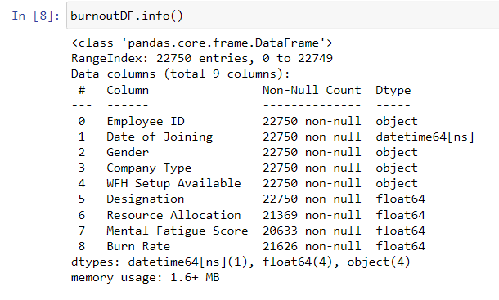
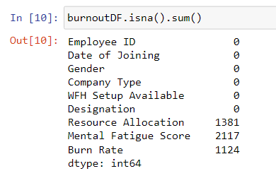
Data Cleaning Here we can see there are some null values out of 22750 total values and we need handle them either by elimination or by filling with appropriate values.

Slide 9
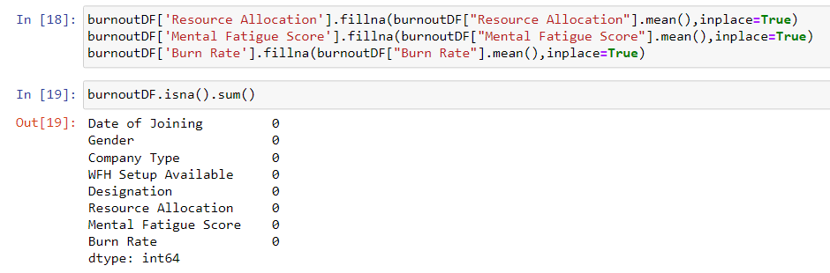
We have filled the null values with the mean values of their respective columns so all the values are filled up.
We have removed the EmployeeID column which is of no use in prediction burn_rate.

Slide 10
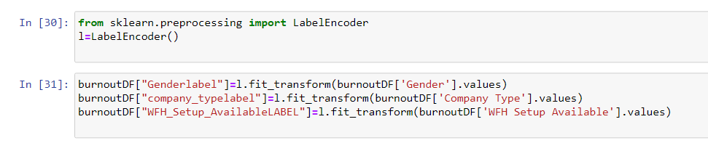
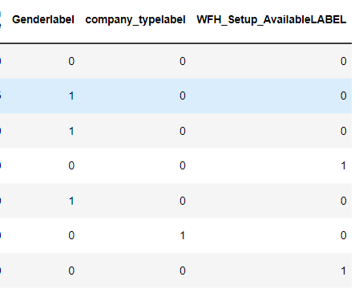
In above pic’s we have transformed the categorical variables into numerical values using LabelEncoder, because to ease the training of the model.

Slide 11
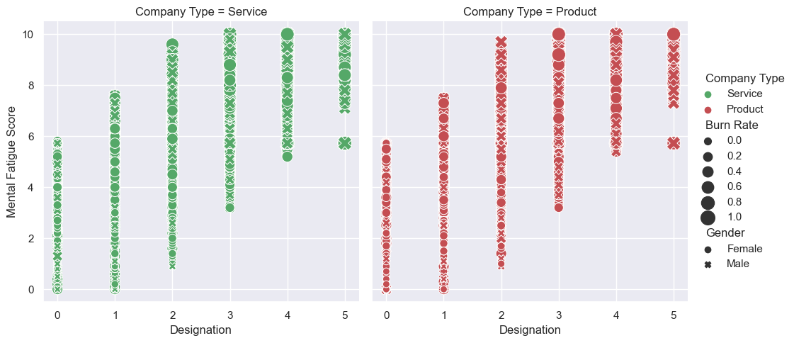
Insights Generated We can see people with more designation(job level) are having the highest Mental Fatigue score, obviously where they have handled the more work either it is in product or service company or whether the employee is a male or female person.

Slide 12
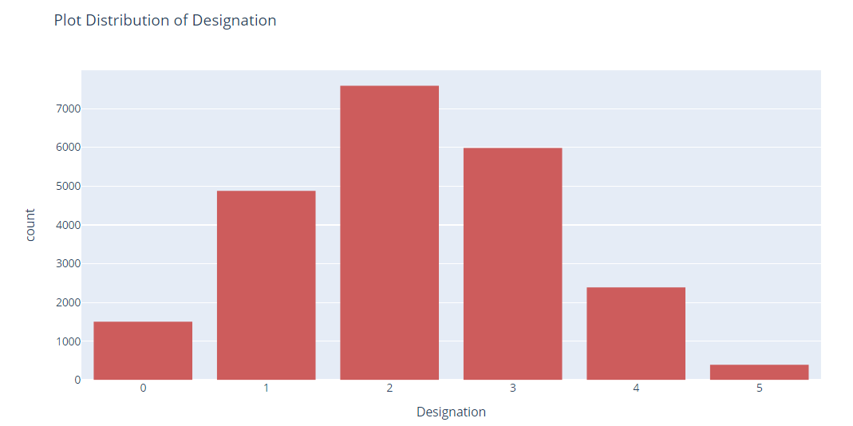
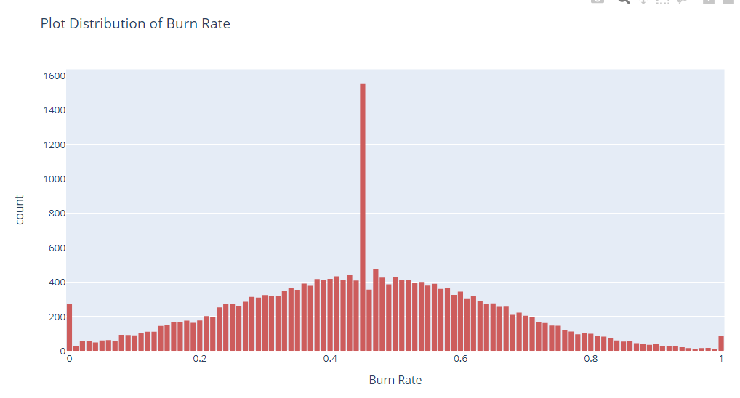
In first picture, people with designation(job role by level) 2 are the highest followed by designation level 3 and then 2 and 5 being the least of all and they are the ones have high burn rate.
In second picture, the highest count of burn rate is 1555 and the range is 0.44 – 0.45, whereas the highest burn rate range of 0.99 – 1.00 are 85 people.

Slide 13
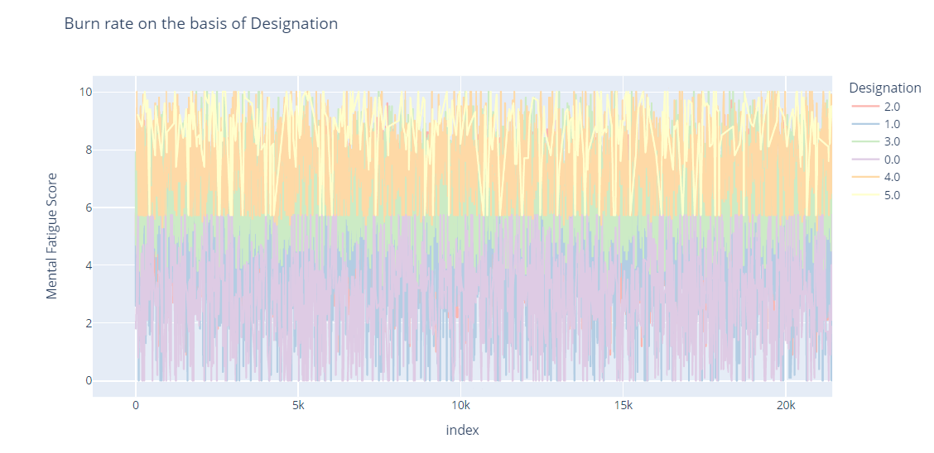
Here we could see people with low designation level like 1,2,3 are mostly below 6 burn rate, where as the people with Designation 4,5 are present in the above 6 range indicating they have the high burn rate.

Slide 14
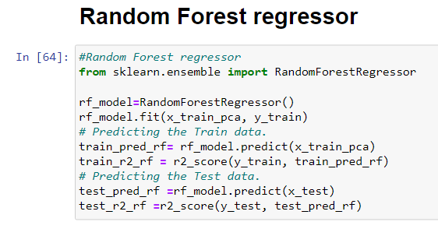
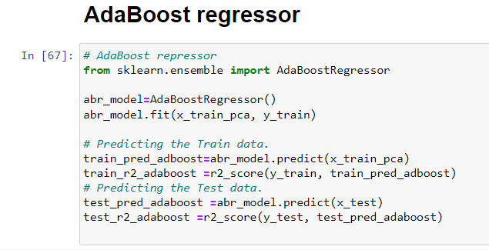
Modelling
Here we have trained both the models they are Random Forest Regressor and the Adaboost Regressor using the method call .fit()
Along with that I have predicted the model’s r2_score for both the training and the testing set and I have printed it in the next slide.

Slide 15
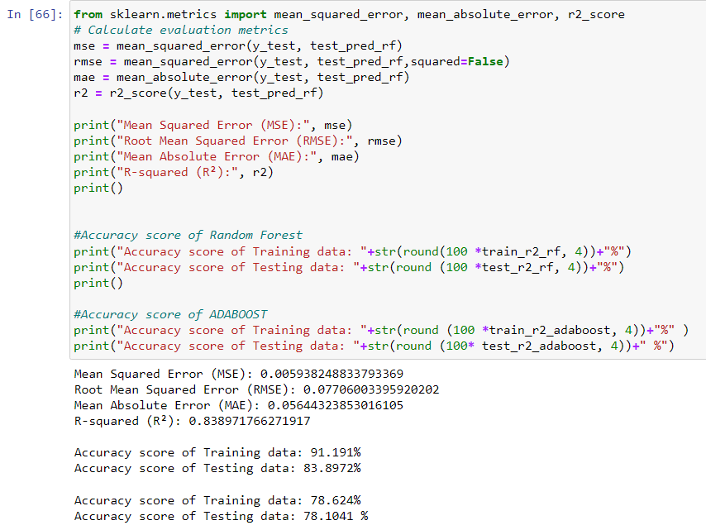
Results
As we see that the accuracy of the RandomForest is Good compared to AdaBoost but it is a bit overfitting, where in the AdaBoost even the accuracy is low it has predicting quite well.

Slide 16
Links
Link 1:
https://skillsbuild.edunetworld.com/courses/ai/employees-burnout-analysis-&-prediction/
Link 2:
https://www.researchgate.net/publication/348434829_Using_Machine_Learning_in Burnout_Prediction_A_Survey
Data Set Link:
https://www.kaggle.com/code/mazharjamdar/employee-burnout

Slide 17
Thank you..

